Slide 1
Data Link Control
Line Discipline
Flow Control
Error Control
WCB/McGraw-Hill
© The McGraw-Hill Companies, Inc., 1998

Slide 2
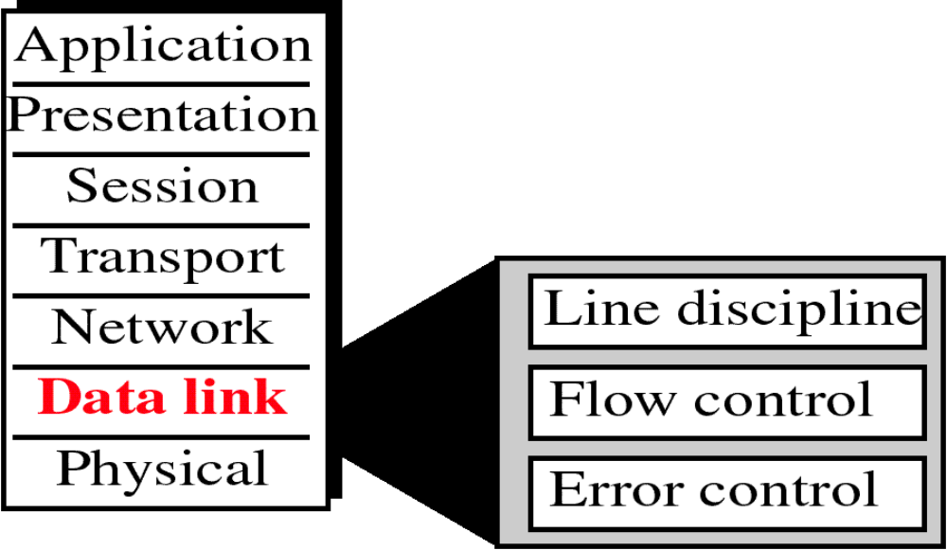
Figure 10-1
Data Link Layer
WCB/McGraw-Hill
© The McGraw-Hill Companies, Inc., 1998

Slide 3
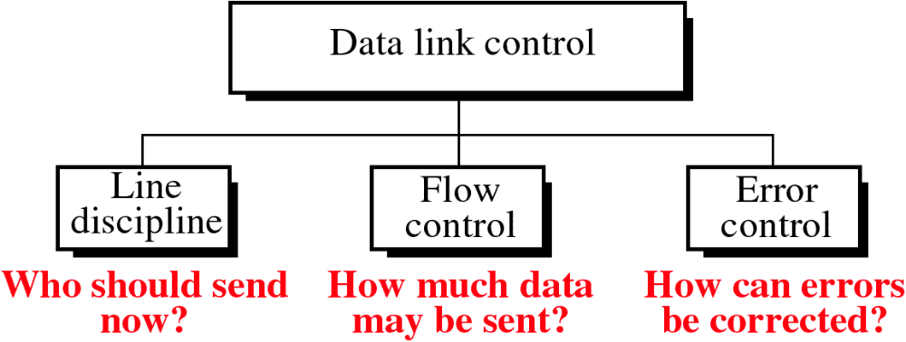
Figure 10-2
WCB/McGraw-Hill
© The McGraw-Hill Companies, Inc., 1998

Slide 4
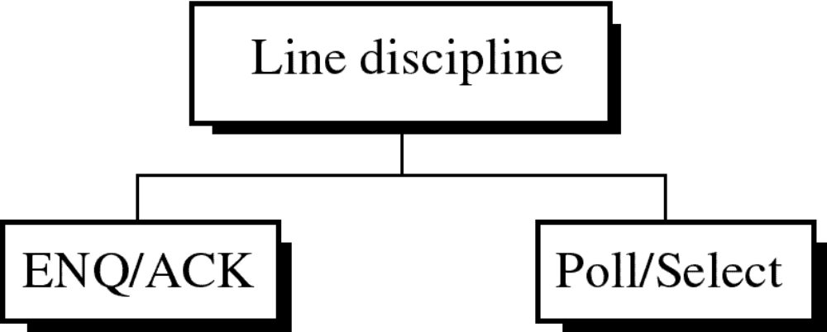
Figure 10-3
WCB/McGraw-Hill
© The McGraw-Hill Companies, Inc., 1998

Slide 5
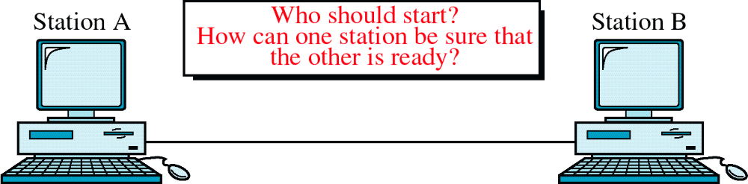
Figure 10-4
ENQ/ACK
WCB/McGraw-Hill
© The McGraw-Hill Companies, Inc., 1998

Slide 6
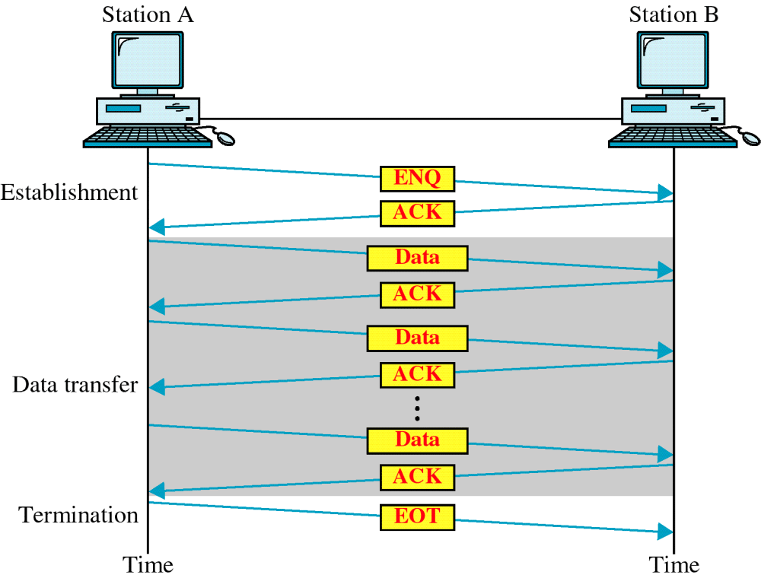
Figure 10-5
ENQ/ACK
WCB/McGraw-Hill
© The McGraw-Hill Companies, Inc., 1998

Slide 7
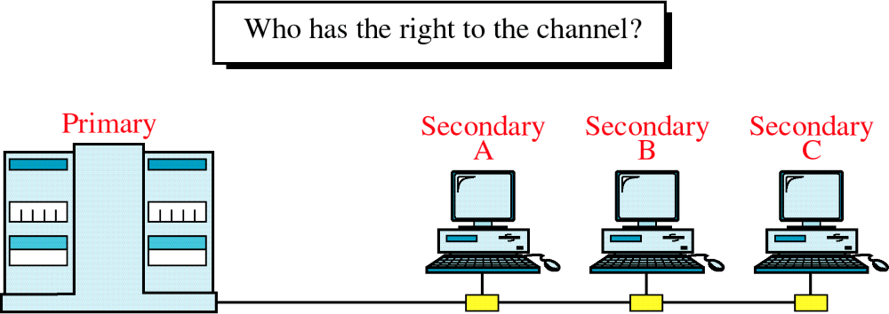
Figure 10-6
Multipoint Discipline
WCB/McGraw-Hill
© The McGraw-Hill Companies, Inc., 1998

Slide 8
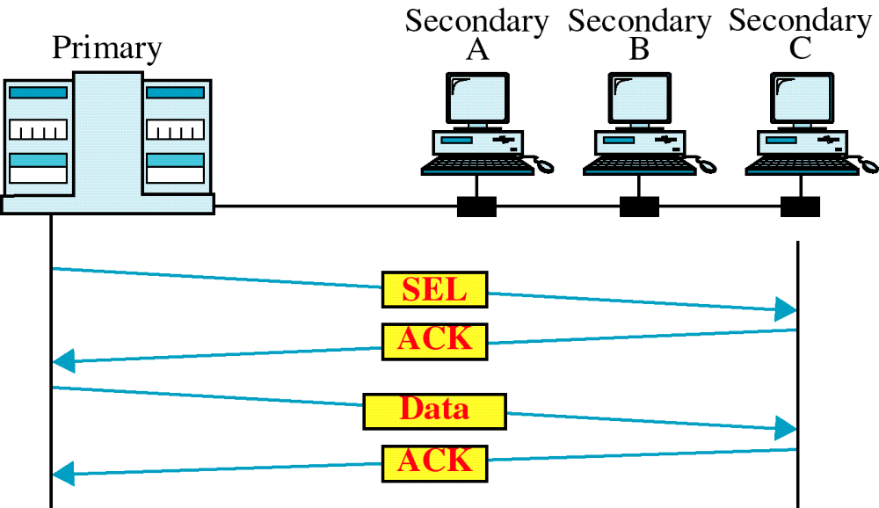
Figure 10-7
Select
WCB/McGraw-Hill
© The McGraw-Hill Companies, Inc., 1998

Slide 9
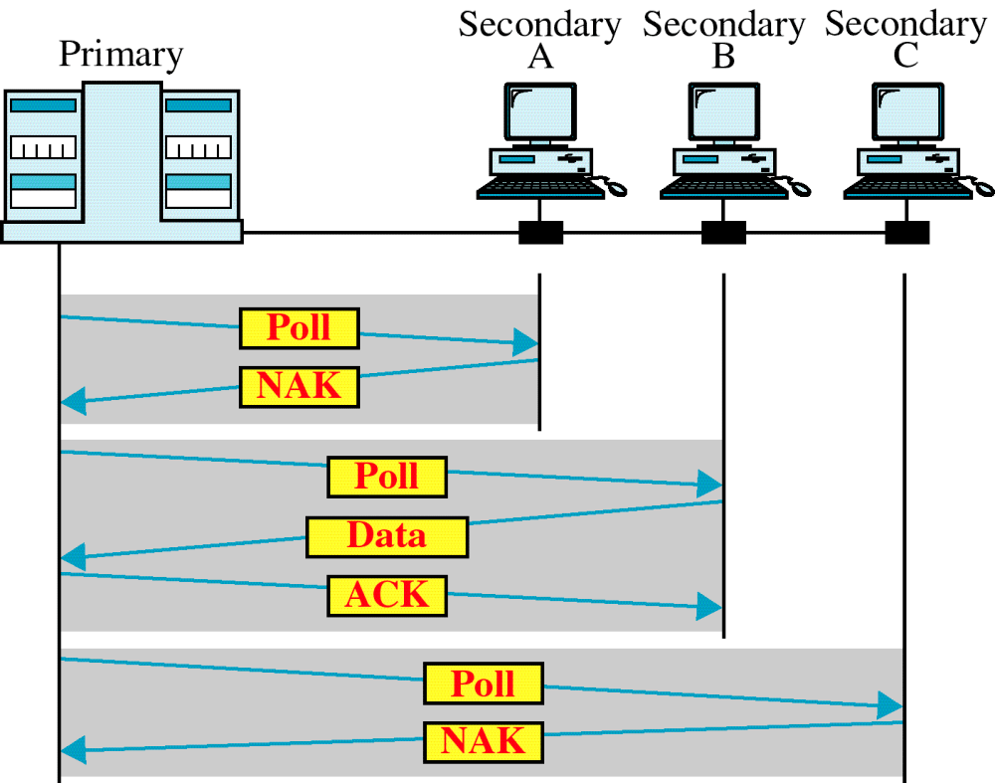
Figure 10-8
Poll
WCB/McGraw-Hill
© The McGraw-Hill Companies, Inc., 1998

Slide 10
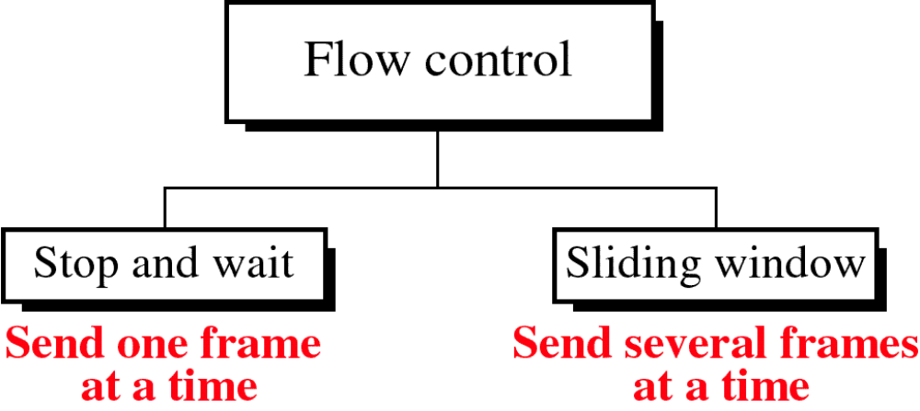
Figure 10-9
WCB/McGraw-Hill
© The McGraw-Hill Companies, Inc., 1998

Slide 11
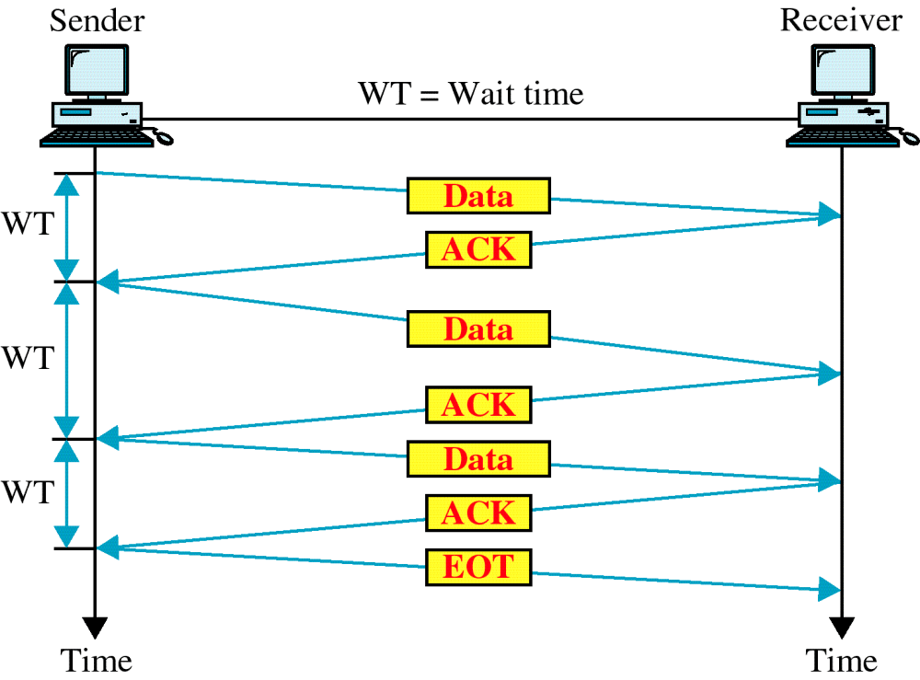
Figure 10-10
Stop and Wait
WCB/McGraw-Hill
© The McGraw-Hill Companies, Inc., 1998

Slide 12
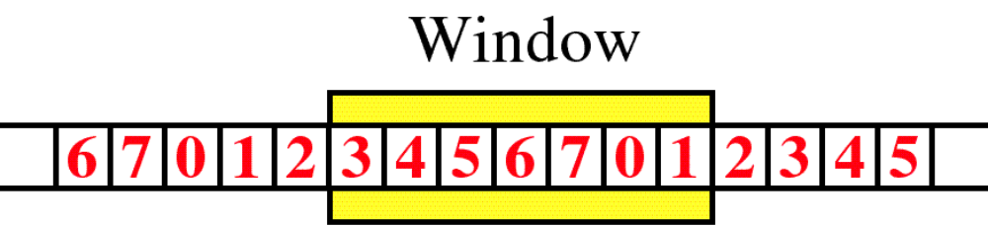
Figure 10-11
Sliding Window
WCB/McGraw-Hill
© The McGraw-Hill Companies, Inc., 1998

Slide 13
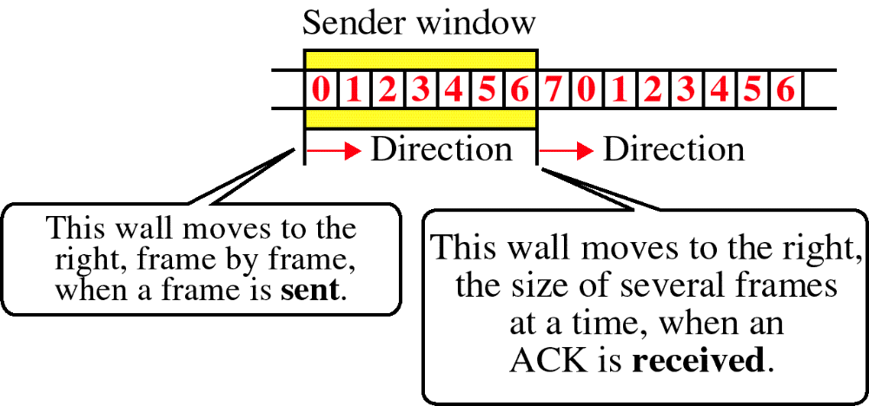
Figure 10-12
Sender Sliding Window
WCB/McGraw-Hill
© The McGraw-Hill Companies, Inc., 1998

Slide 14
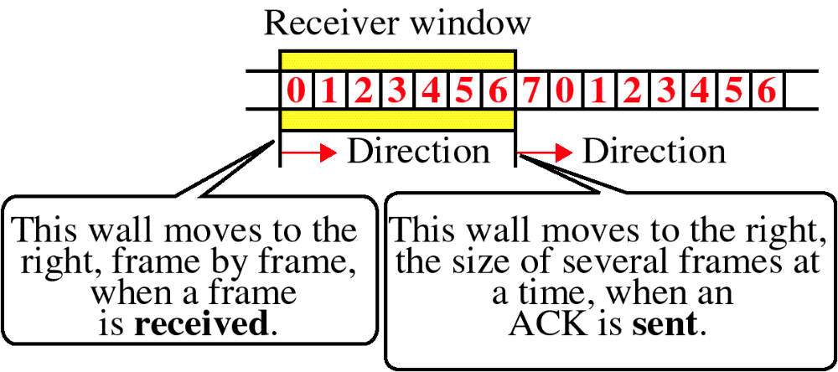
Figure 10-13
Receiver Sliding Window
WCB/McGraw-Hill
© The McGraw-Hill Companies, Inc., 1998

Slide 15
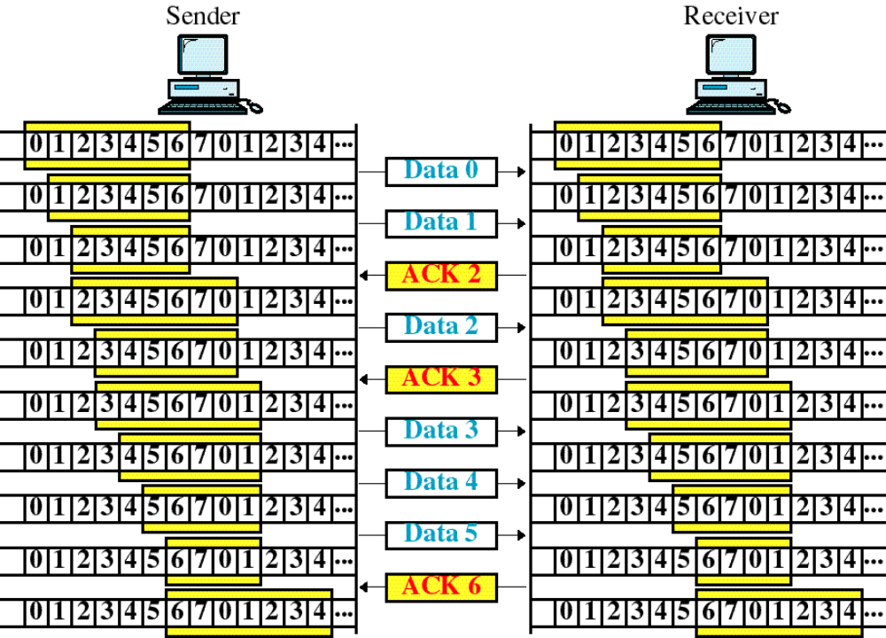
Figure 10-14
Sliding Window Example
WCB/McGraw-Hill
© The McGraw-Hill Companies, Inc., 1998

Slide 16
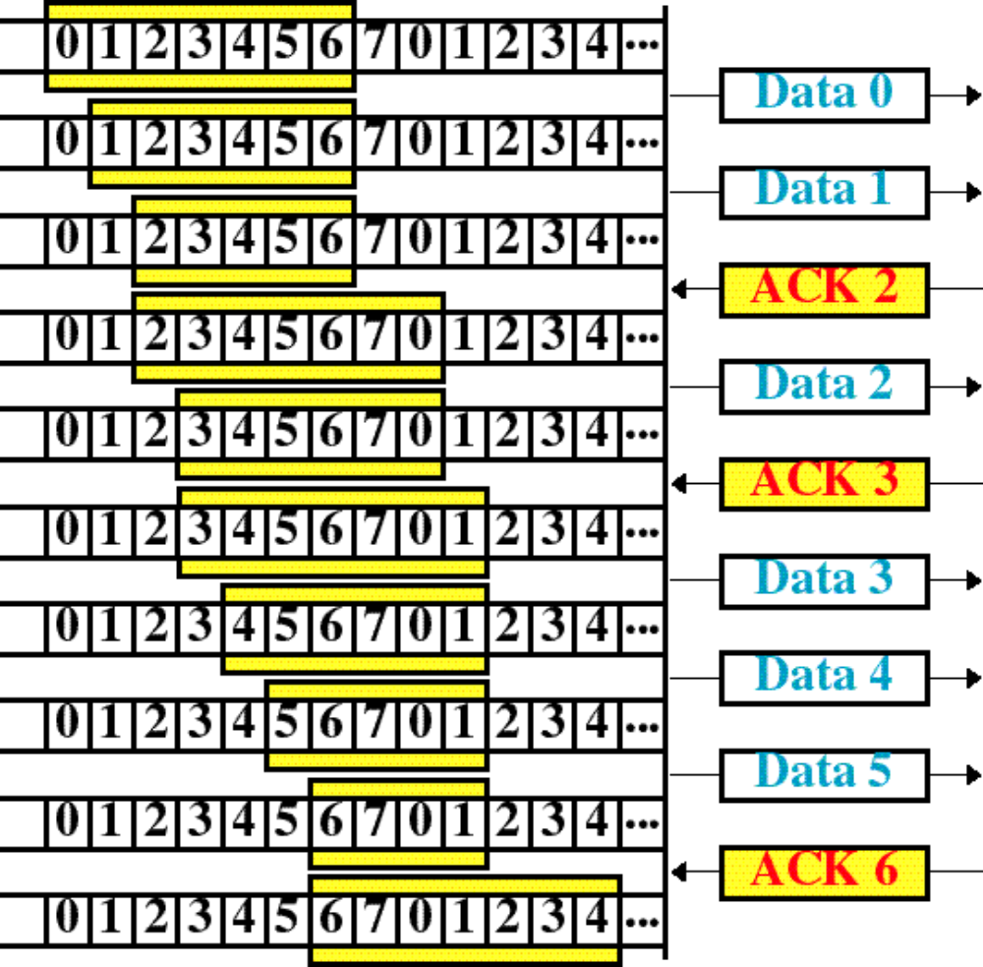
Figure 10-14-continued
Sender
WCB/McGraw-Hill
© The McGraw-Hill Companies, Inc., 1998

Slide 17
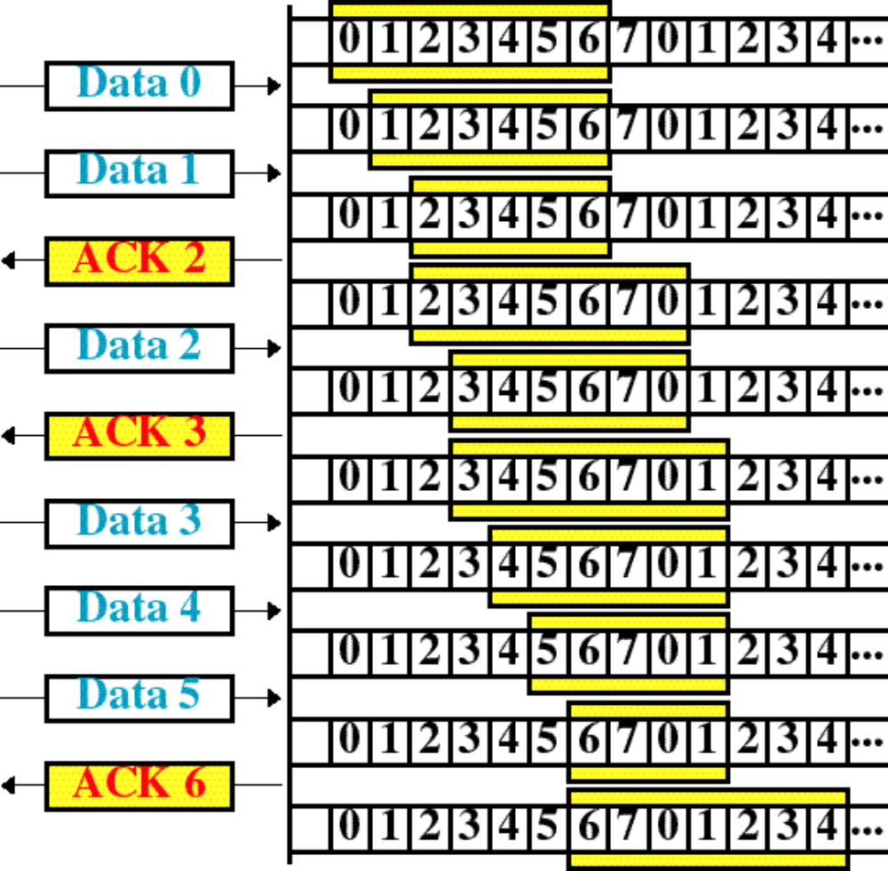
Figure 10-14-continued
Receiver
WCB/McGraw-Hill
© The McGraw-Hill Companies, Inc., 1998

Slide 18
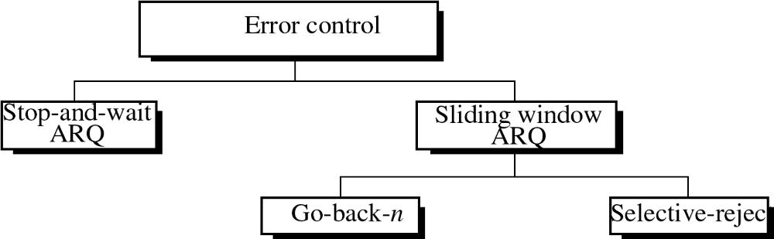
Figure 10-15
WCB/McGraw-Hill
© The McGraw-Hill Companies, Inc., 1998

Slide 19
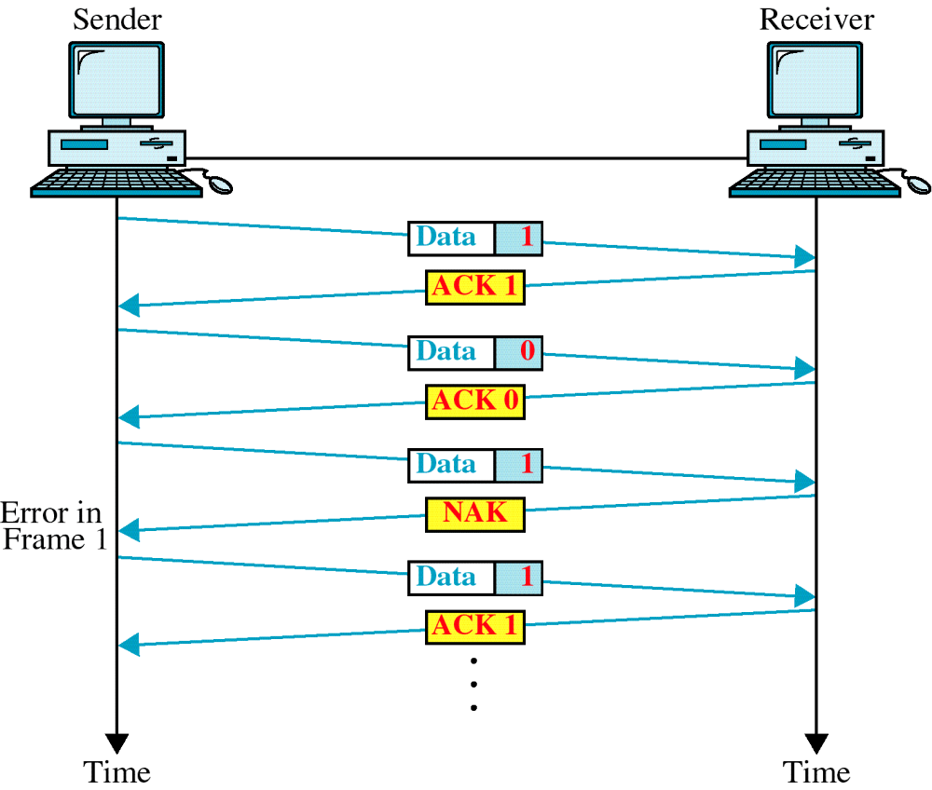
Figure 10-16
Damaged Frame
WCB/McGraw-Hill
© The McGraw-Hill Companies, Inc., 1998

Slide 20
Figure 10-17
Lost Frame
WCB/McGraw-Hill
© The McGraw-Hill Companies, Inc., 1998

Slide 21
Figure 10-18
Lost ACK
WCB/McGraw-Hill
© The McGraw-Hill Companies, Inc., 1998

Slide 22
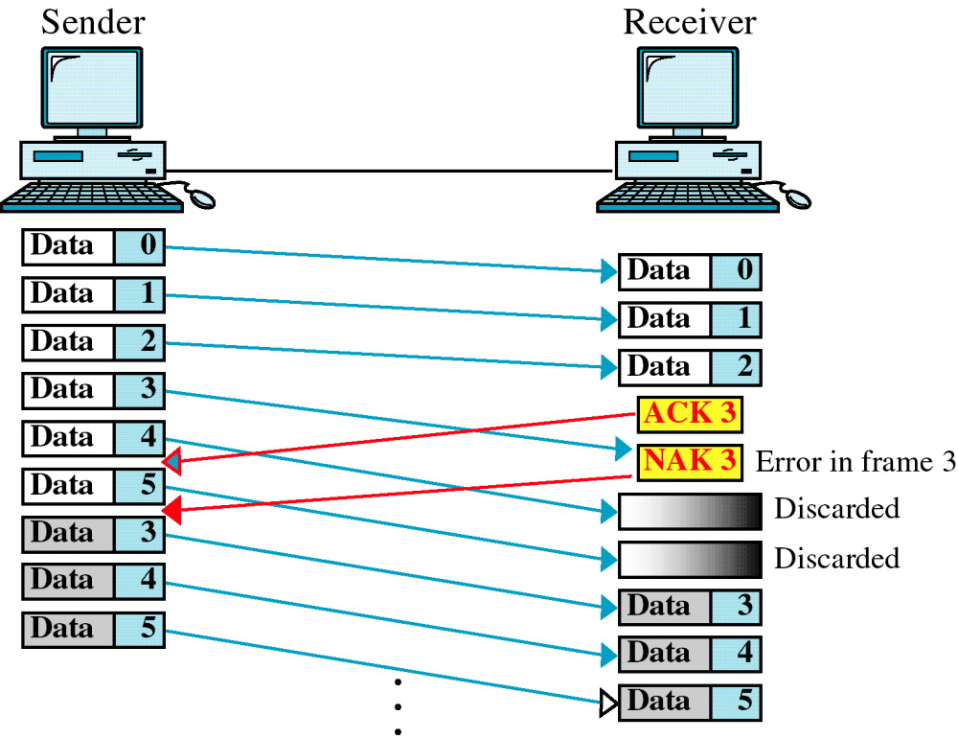
Figure 10-19
Damaged Frame
WCB/McGraw-Hill
© The McGraw-Hill Companies, Inc., 1998

Slide 23
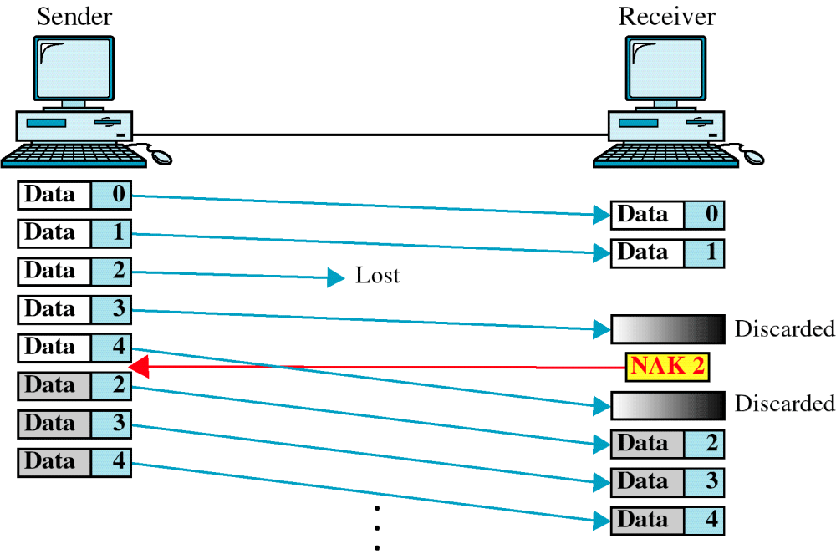
Figure 10-20
Lost Frame
WCB/McGraw-Hill
© The McGraw-Hill Companies, Inc., 1998

Slide 24
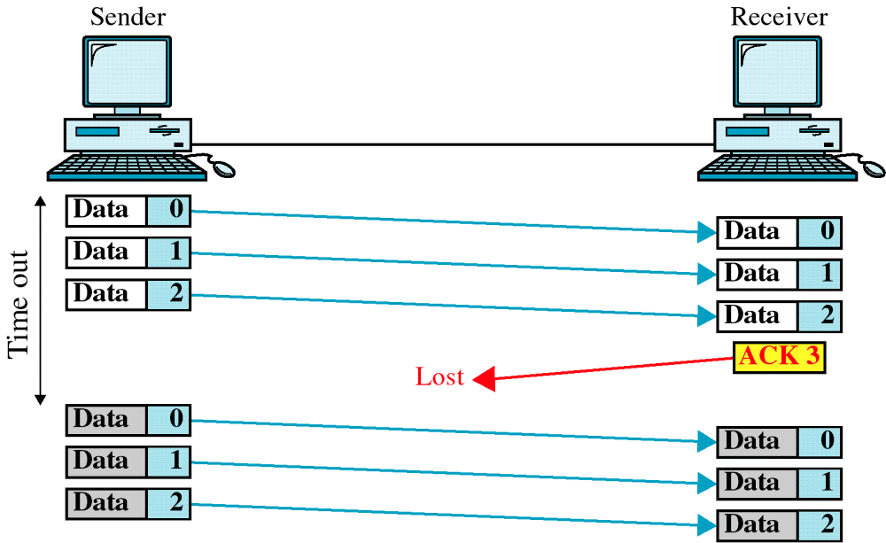
Figure 10-21
Lost ACK
WCB/McGraw-Hill
© The McGraw-Hill Companies, Inc., 1998

Slide 25
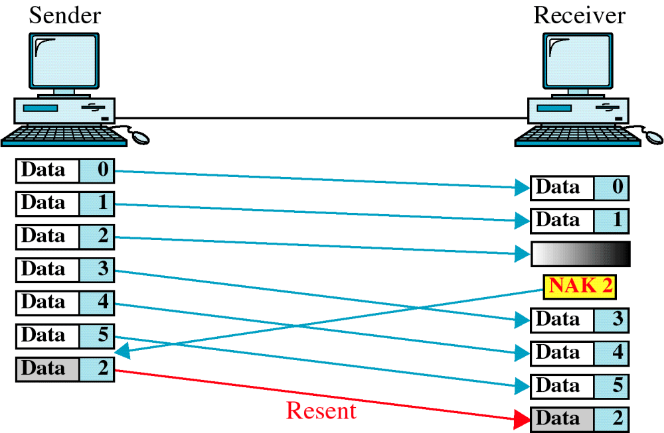
Figure 10-22
Selective Reject
WCB/McGraw-Hill
© The McGraw-Hill Companies, Inc., 1998

